Slide 1


New York
_Airbnb_
Business Analytics

Slide 2

New York
Borough | Population
Brooklyn | 2,561,225
Queens | 2,252,196
Manhattan | 1,597,451
Bronx | 1,356,476
Staten Island | 490,687
1. Brooklyn
- A blend of cultural diversity, arts, and residential communities.
2. Queens
- The most ethnically diverse borough
3. Manhattan
- The economic, financial, and cultural heart of New York City
4. Bronx
- A borough with rich history and cultural heritage.
5. Staten Island
- A quiet, suburban borough with a strong residential character

Slide 3


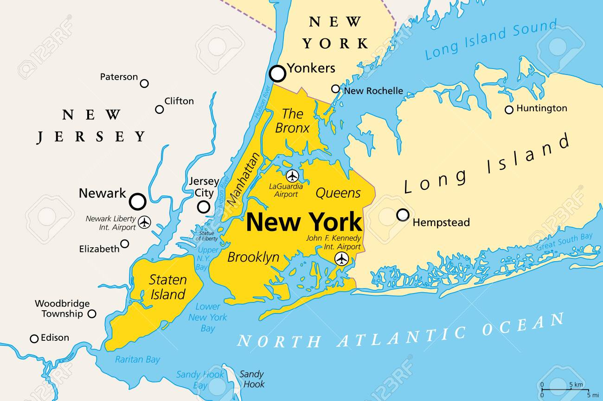
Part 1
Motivation

Slide 4
Part 1
Insights into NYC Airbnb Market
Airbnb
- Airbnb revolutionized the short-term rental market.
New York City:
- Globally known for high housing and accommodation costs.
- Manhattan: One of the most expensive areas in the U.S.
Notes:
New York City is globally recognized for its high housing and accommodation costs, with Manhattan being one of the most expensive areas to live in the United States. In this context, analyzing regional differences and price variability in NYC, and understanding how accommodation types (room types) influence prices in high-cost areas, provides valuable insights for hosts, travelers, and policymakers alike.
This project aims to investigate the price differences between Manhattan and other areas, the range of price variability, and the relative importance of private rooms in high-cost regions.

Slide 5

Part 2
Analytics Goals

Slide 6
Part 2
Business and Analytical Goals of the Project
1
2
Understanding Regional
Price Variability
Identifying the Strategic Importance of Room Types
3
Enhancing Predictive Modeling and Decision-Making
Notes:
Understanding Regional Price Variability
Quantify the price variability in high-cost areas such as Manhattan.
Analyze how price fluctuations are influenced by factors like:
Housing costs
Tourism demand
Regulatory environments.
2. Identifying the Strategic Importance of Room Types
Examine the impact of room types (e.g., Private room) on price formation in high-cost areas.
Provide actionable insights for hosts to:
Select optimal accommodation types.
Develop effective pricing strategies.
3. Enhancing Predictive Modeling and Decision-Making
Develop tailored price prediction models using:
Separate data frames for Manhattan and non-Manhattan areas.
Support more accurate and context-specific decision-making for stakeholders.

Slide 7
Part 2
Stakeholders in the NYC Airbnb Market
Set optimal pricing strategies.
Adjust minimum stay requirements.
Maximize profitability and competitiveness in the market.
Offer customized filtering and search features for users.
Hosts
Platform Operators (Airbnb)
Policymakers and Public Institutions
Local Communities and Tourism Industry
Balanced regulatory policies
in the short-term rental market.
Regional development plans.
Local businesses and tourism operators to better predict demand.
Communities to prepare for increased tourism or rising housing costs.
Notes:
how this project can create value

Slide 8


Part 3
Impact & Contribution

Slide 9
Part 3
In reality
Short-term rental regulation
High Price
The burden of housing expenses
A
housing shortage
Notes:
"In Manhattan, Airbnb contributes to rising housing costs. Residential spaces are often converted into short-term rentals, increasing rent burdens and reducing availability for long-term residents.”
"These trends threaten the stability of local communities and create housing shortages. In response, cities like New York have implemented strict short-term rental regulations, 2023.
"In summary, the rise of Airbnb reshapes urban housing environments, impacting not only individual hosts and travelers but entire communities.

Slide 10

Part 4
Data Set

Slide 11
Part 4
From Kaggle
48,895 rows and 16 columns
1. id: Unique ID of the Airbnb listing.
2. name: Name of the listed property.
3. host_id: Unique ID of the host.
4. host_name: Name of the host.
5. neighbourhood_group: General region of the location (neighborhood), e.g., Brooklyn, Manhattan, Queens, Staten Island, and Bronx.
6. neighbourhood: Specific neighborhood where the property is located.
7. latitude: Latitude coordinate of the property.
8. longitude: Longitude coordinate of the property.
9. room_type: Type of room (e.g., Private room, Shared room, Entire home/apt).
10. price: Price per night (in USD).
11. minimum_nights: Minimum number of nights guests are required to stay.
12. number_of_reviews: Number of reviews the listing has received.
13. last_review: Date of the last review.
14. reviews_per_month: Average number of reviews per month.
15. calculated_host_listings_count: Total number of properties listed by the host.
16. availability_365: Number of days the property is available in a year.

Slide 12
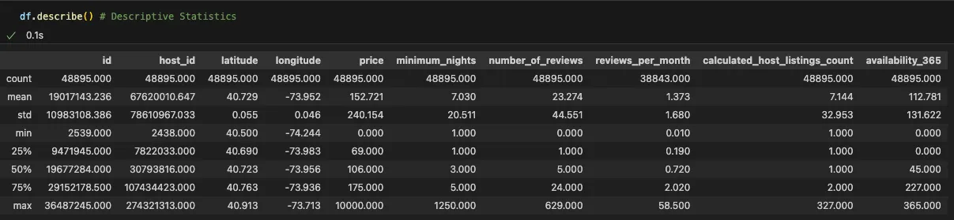
Part 4
Descriptive Statistics

Slide 13
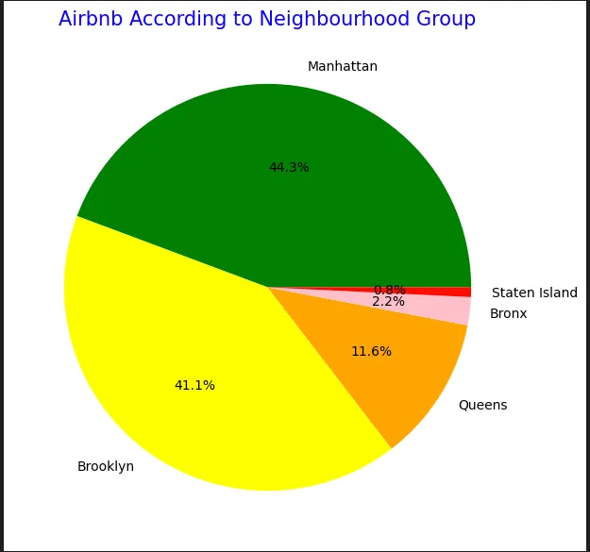
Part 4
Distribution by Neighbourhood Group

Slide 14
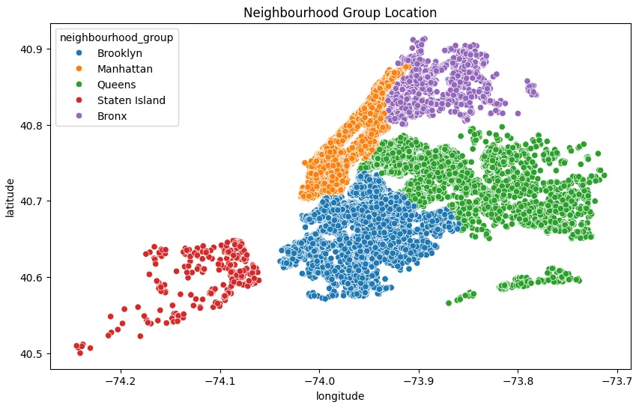
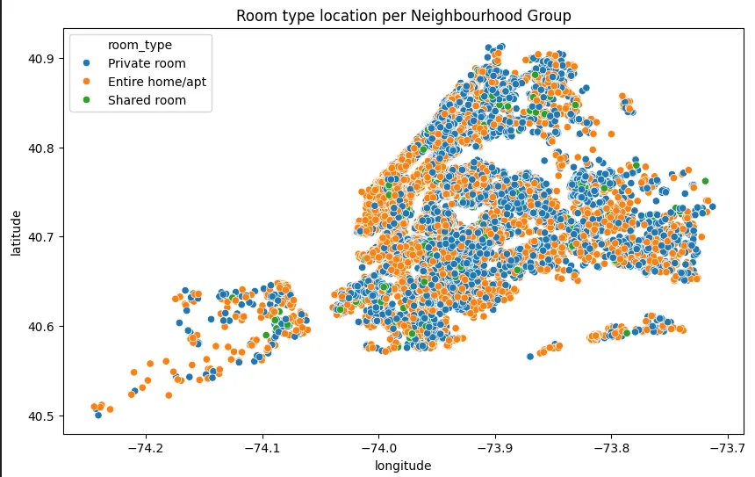
Part 4
Location Based on Neighbourhood Group and Room Type

Slide 15
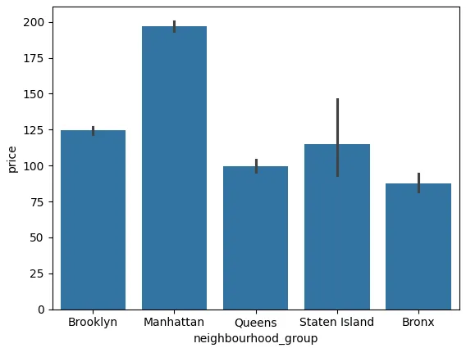
Part 4
Neighbourhood Group vs Price

Slide 16
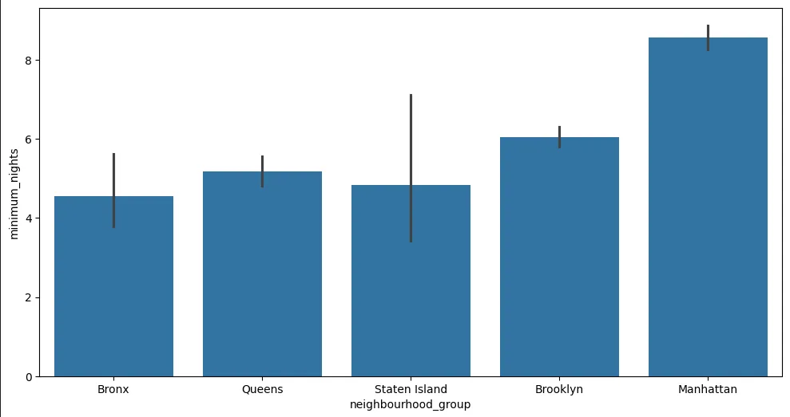
Part 4
Neighbourhood Group vs minimum_nights

Slide 17
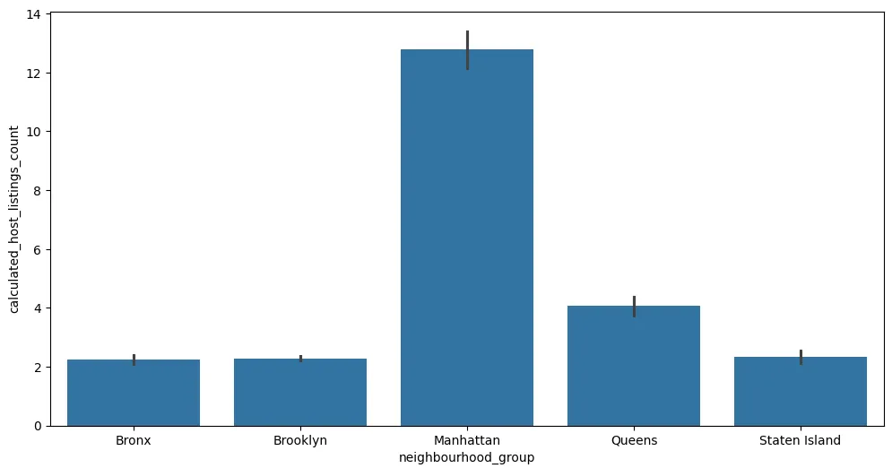
Part 4
Neighbourhood Group vs calculated_host_listings_count

Slide 18
Part 5
Models

Slide 19
Part 5
Models
1. Linear Regression: Basic linear regression model.
2. Ridge Regression: Linear regression with L2 regularization to prevent overfitting.
3. Lasso Regression: Linear regression with L1 regularization for variable selection.
4. ElasticNet: Combines L1 and L2 regularization
5. K-Nearest Neighbors (KNN): Non-linear model that makes predictions based on nearby data points.
6. CART (Decision Tree): Non-linear model based on decision trees..
7. Random Forest (RF): Ensemble model combining multiple decision trees.
8. CatBoost: Gradient Boosting-based model with strong performance on categorical data

Slide 20
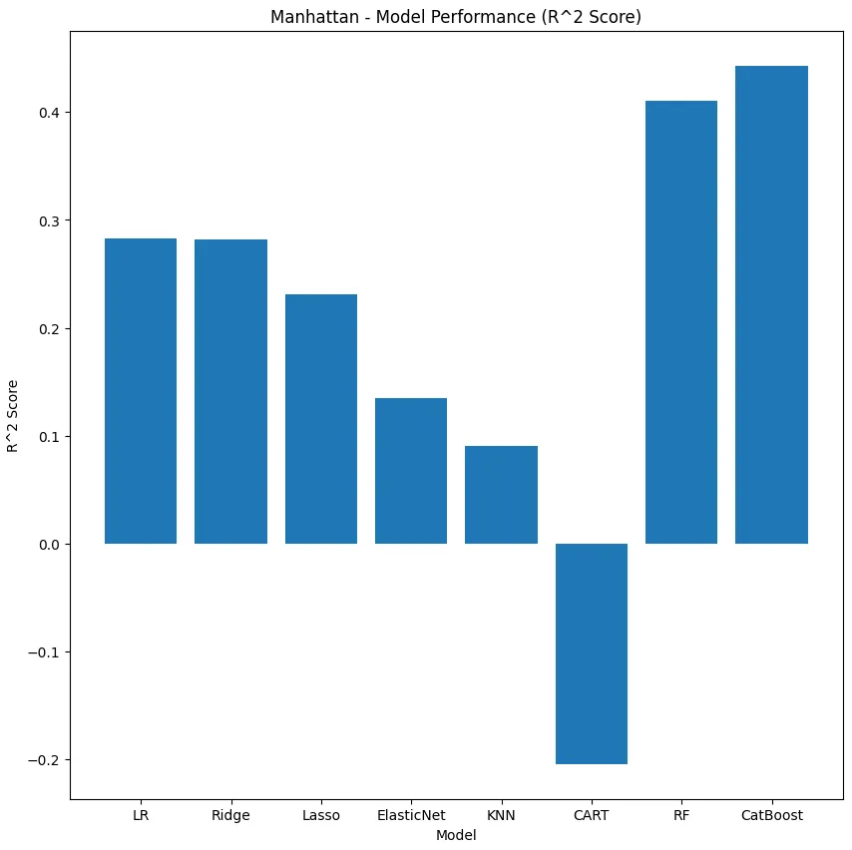
Part 5
Model – R^2 Score

Slide 21
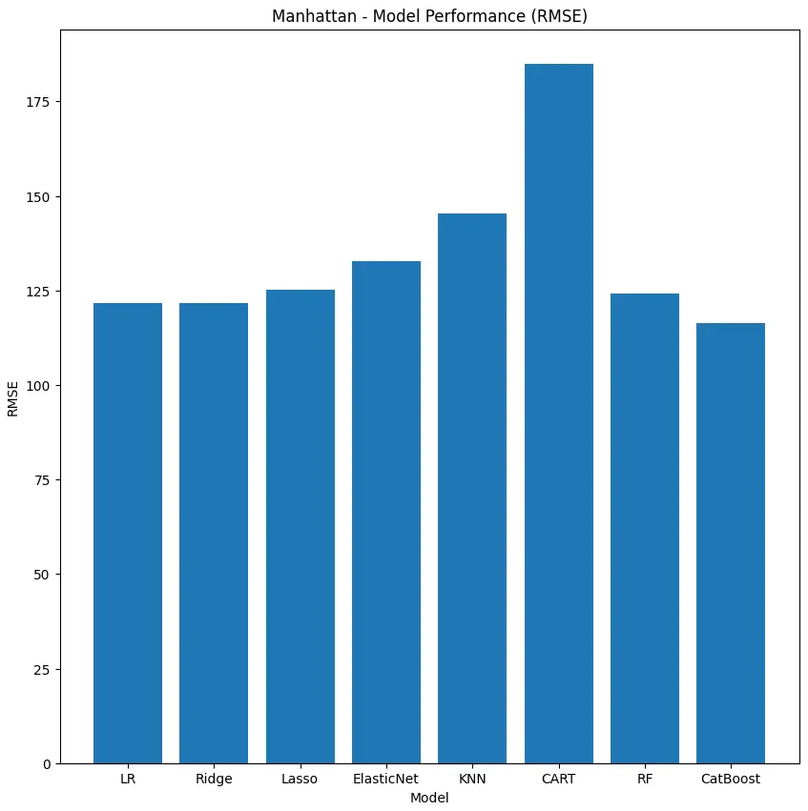
Part 5
Model – RMSE
Notes:
RMSE: Root Mean Square

Slide 22
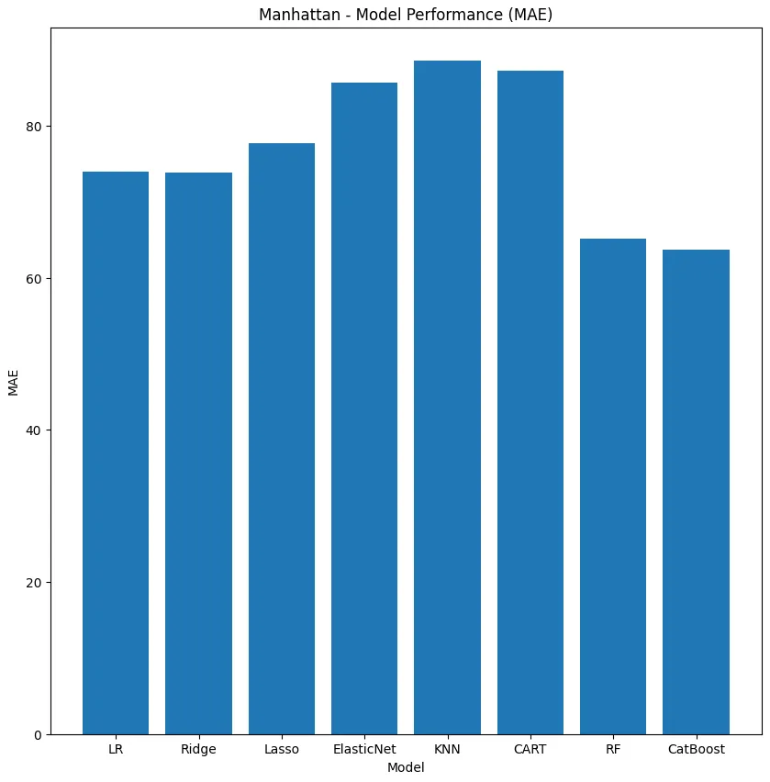
Part 5
Model – MAE
Notes:
MAE: Mean Absolute Error

Slide 23
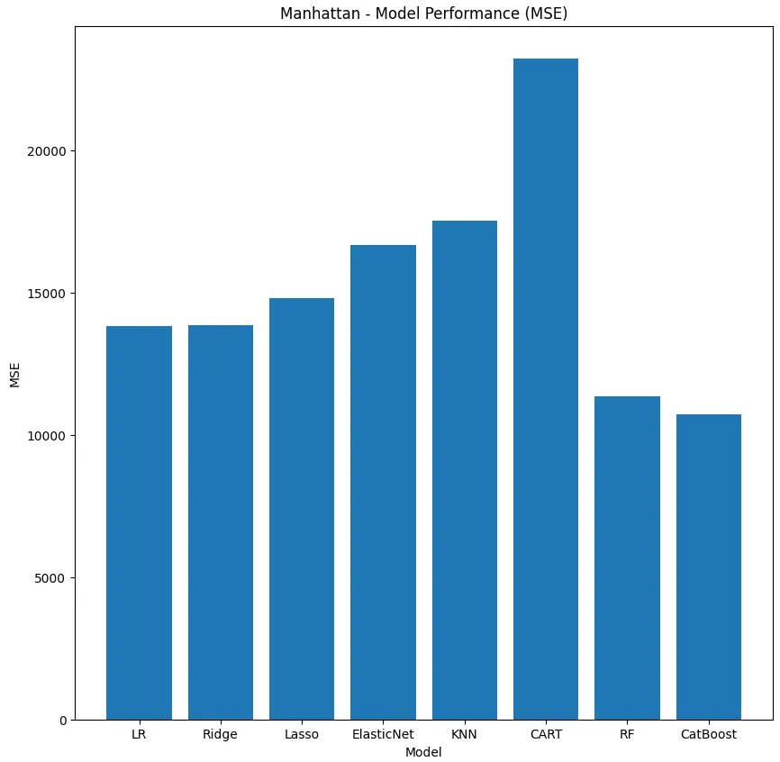
Part 5
Model – MSE
Notes:
MSE: Mean Square Error

Slide 24
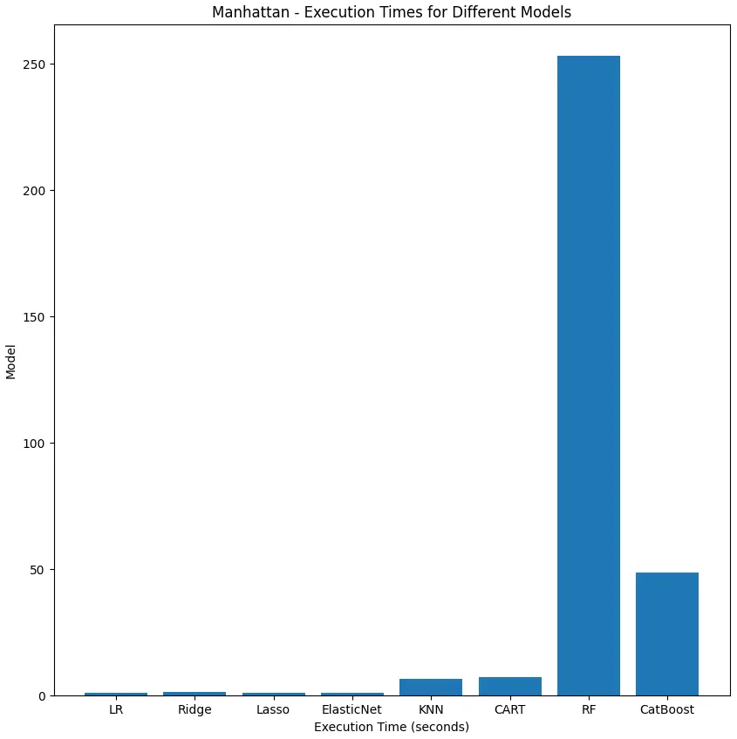
Part 5
Model – Execution Time

Slide 25
Part 5
Best Model
Best Model :
1. CatBoost: Achieved the highest performance (R² Score: 0.4431).
Others :
2. Random Forest: Second-best performance but has the longest execution time.
3. Linear Regression/Ridge: Basic models with fast execution times and decent performance.
4. Lasso/ElasticNet: Enables variable selection through regularization but shows slightly lower performance.
5. KNN: High computational cost with relatively low performance.
6. CART: Recorded the lowest performance among all models.

Slide 26
Part 5
CatBoost
Strengths:
1. Automatically handles categorical data.
2. Prevents overfitting and delivers high performance.
3. Efficient training speed with excellent generalization capabilities.
Weakness
1. Execution time can be slow, especially with large datasets.
2. Hyperparameter tuning can be complex.
3. Performance may decline with insufficient training data.

Slide 27
References
https://www.citypopulation.de/en/usa/newyorkcity
https://www.costar.com/article/230699136/manhattan-named-the-nations-most-expensive-place-to-live-by-new-report
Koster, H. R. A., van Ommeren, J., & Volkhausen, N. (2021). Short-term rentals and the housing market: Quasi-experimental evidence from Airbnb in Los Angeles. Journal of Urban Economics, 124, 103356. https://doi.org/10.1016/j.jue.2021.103356
https://www.wired.com/story/airbnb-ban-new-york-city
https://www.kaggle.com/datasets/dgomonov/new-york-city-airbnb-open-data/data

Slide 28


THANK YOU :)
Sources
https://www.timeshighereducation.com/blog/struggling-south-korean-universities-should-tap-indian-market
https://annyeongindia.com/popular-korean-universities-and-scholarships-among-indian-students/
https://www.adriel.com/ko/blog/advertising-metrics-benchmarks
http://moksin.duranno.com/moksin/view/article.asp?articleNO=38499
https://pib.gov.in/PressReleaseIframePage.aspx?PRID=1894517

